Slide 1

Watch-dog timer:
A watch-dog timer is a timer that is used to detect and recover from software errors.
It is typically used in safety-critical systems where a software error could have serious consequences.

Slide 2
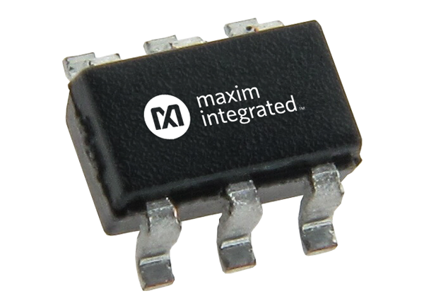
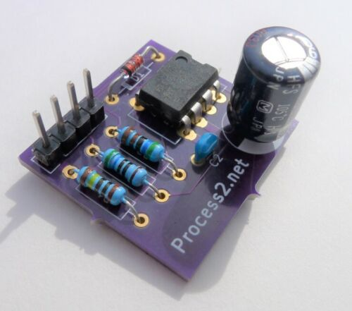

Slide 3
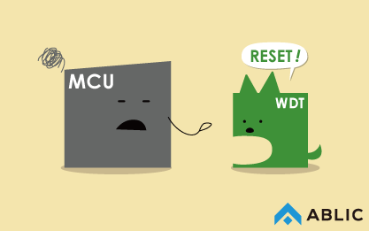
https://www.ablic.com/en/semicon/products/automotive/automotive-watchdog-timer/intro/

Slide 4
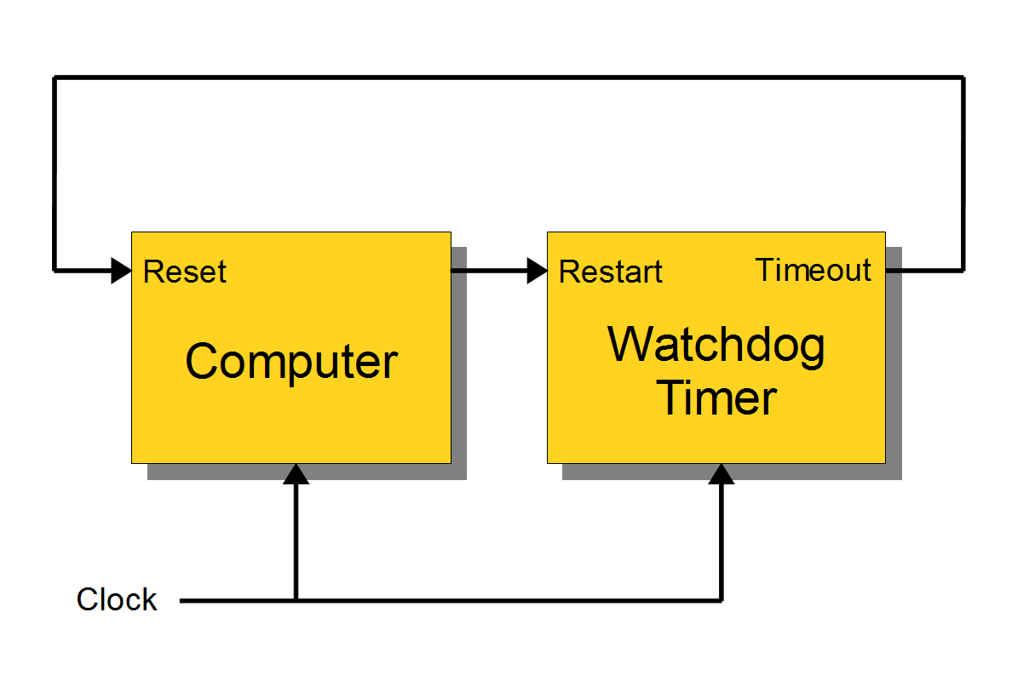

Slide 5
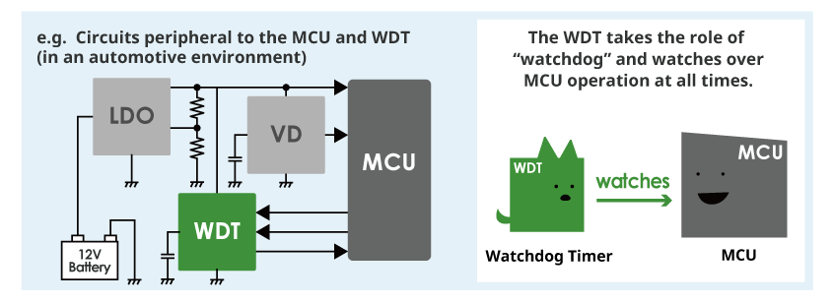

Slide 6
1. Timeout Mode:
The most common mode. The WDT counts down and triggers an action (like reset) if not "petted" before the timer reaches zero.
Good for detecting stuck software or hardware issues.
Drawback: Might miss issues if the malfunction prevents "petting" the timer altogether.

Slide 7
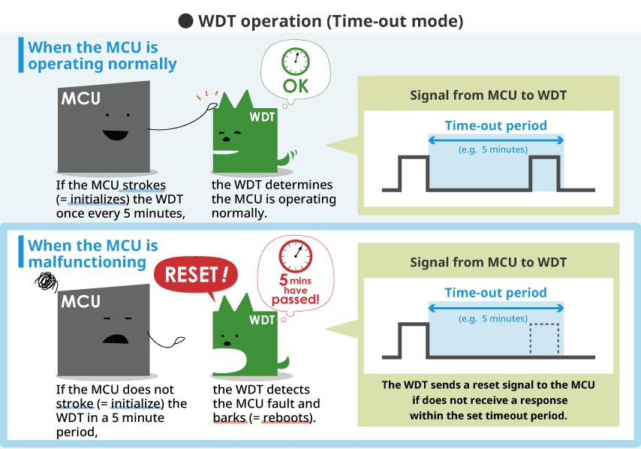

Slide 8
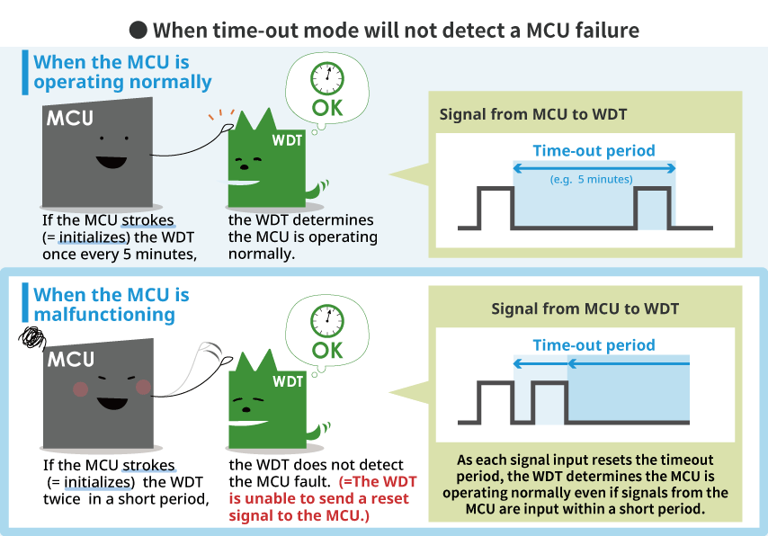

Slide 9
Window Mode:
Similar to timeout, but defines a window of acceptable "petting" times.
The system must "pet" the timer within a specific range before and after a designated point.
More flexible, allowing room for processing delays while still catching major issues.

Slide 10
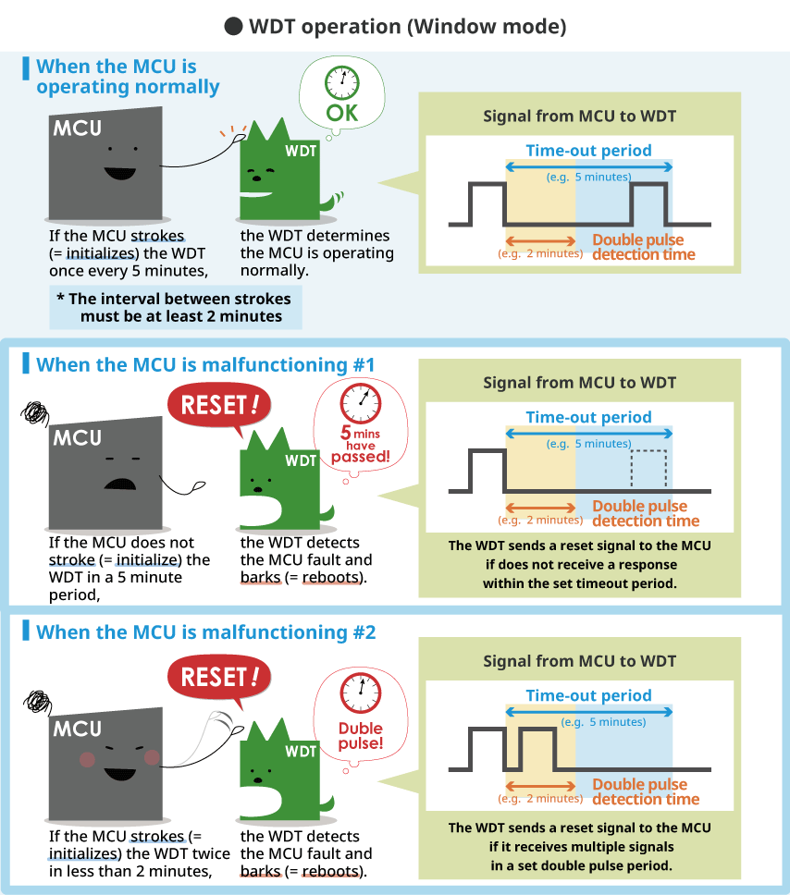

Slide 11
3. Interval Mode:
The WDT counts down and triggers an action each time it reaches zero, requiring continuous "petting".
Useful for applications requiring frequent checks on system health.
Can be more resource-intensive compared to other modes.
4. Software Triggered Mode:
Provides more control. The application itself triggers the timer and can also reset it.
Offers flexibility for specific use cases but requires careful management within the application.
5. Power Management Modes:
Some WDTs offer special modes for power-saving purposes. They might automatically pause or adjust their behavior during sleep or low-power states.

Slide 12
Choosing the Right Mode:
The best WDT mode depends on your specific system and needs. Consider:
Required level of safety and responsiveness: How critical is it to detect issues quickly?
Nature of potential malfunctions: What types of issues do you want to catch?
System resources: How much processing power and memory can you dedicate to the WDT?

Slide 13
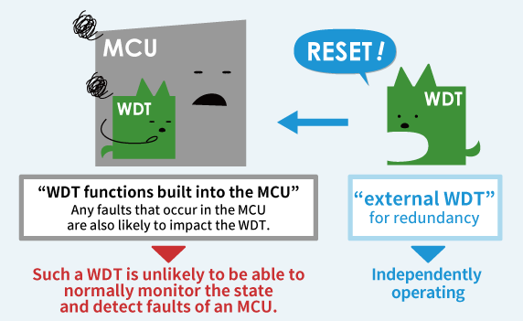
MCU possess internal WDT
Is an “external” WDT necessary?
Extra layer of safety

Slide 14
Choosing the Right Mode:
Selecting the optimal WDT mode depends on your specific needs. Consider factors like system complexity, desired flexibility, and required fault tolerance.
For simple systems prone to hangs, Time-out mode might suffice.
For applications requiring flexibility and longer execution times, Window mode is a good choice.
For enhanced security and critical systems, Q&A mode or an independent WDT offer superior protection.

Slide 15
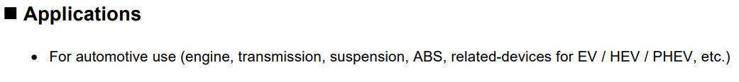


Slide 16
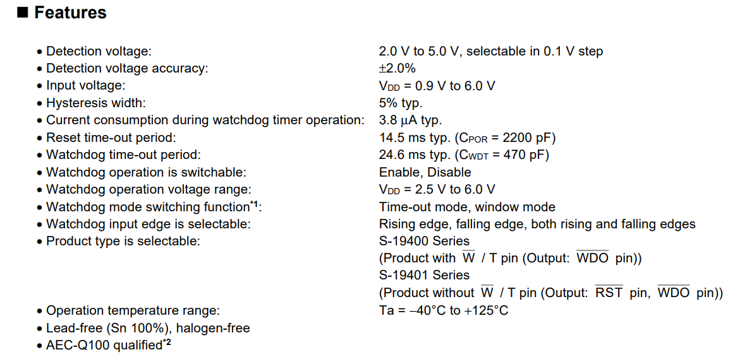

Slide 17
Summary Points about WDT:
A watchdog timer is a timer that is used to detect and recover from software errors. It is typically used in safety-critical systems where a software error could have serious consequences.
The watchdog timer is a hardware timer that is designed to reset the system if the software fails to periodically reset it.
The software must periodically restart the watchdog timer before it expires. If the software fails to restart the watchdog timer, the timer will expire and reset the system.
The watchdog timer is typically used in embedded systems that have no human operator to monitor the system. It is also used in systems where a software error could cause serious damage or injury.

Slide 18
Contd..
The watchdog timer is implemented as a counter that counts down from an initial value. The software must periodically restart the counter before it reaches zero. If the counter reaches zero, the watchdog timer will expire and reset the system.
The watchdog timer can be configured to generate an interrupt before it expires. This allows the software to take corrective action before the system is reset.

